Slide 1
LCHP - 2019
Boston University
Proposed dates: May 27th - June 1st
Also possible: June 3rd – June 8th

Slide 2
Boston
Major Metropolitan area with ~650,000 people in the city of Boston, 4.5 million in greater Boston area
20 major research universities/colleges in the area (Boston University, Harvard, MIT, Northeastern, Brandeis, Tufts, Wellesley…)
Serviced by Logan International Airport, train connections to major east coast cities (NYC, Philadelphia, DC)

Slide 3
Air Travel
Many non-stop daily flights from major European international airports (all major carriers)
e.g. Paris, Amsterdam, Heathrow, Frankfurt and others
2017 ticket prices: ~$800-1000
Many flights per day connect Boston to major US hubs (New York, Atlanta, Washington DC, Chicago, Los Angeles, San Francisco, etc)
2017 ticket prices: ~$200-500 (depending on length of flight)

Slide 4
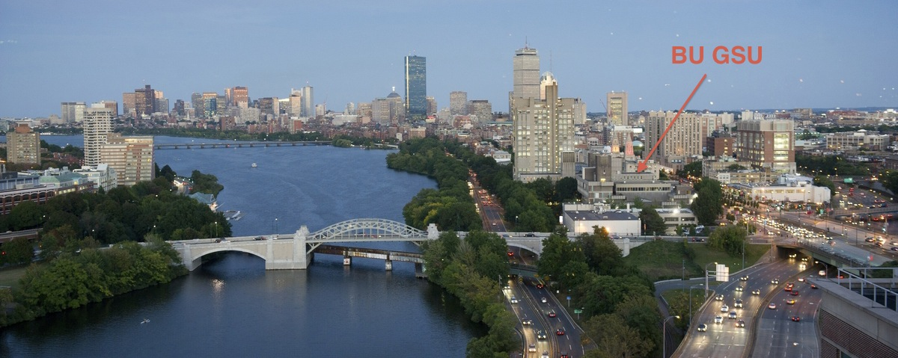
Boston University
Located along Charles River in the city of Boston
Well connected to subway, downtown Boston, the airport, train station, and highway
20-30 min by subway from airport (cost $2.25);
~15-20 min by taxi from airport (cost ~$35);
~33000 students ( approximately half graduate students and half undergraduates), ~4000 faculty

Slide 5
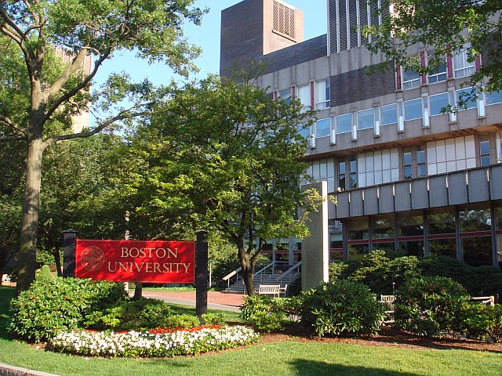
Venue: George Sherman Union (GSU) @ BU
Main conference room can seat:
up to 550 in “classroom configuration” (with fold down desk)
Up to 800 people in “theater configuration
3 Breakout rooms that can seat up to 250 people each
Large Room for poster sessions in entry hall
High bandwidth guest Wi-Fi network available throughout
Power connections are not an issue

Slide 6
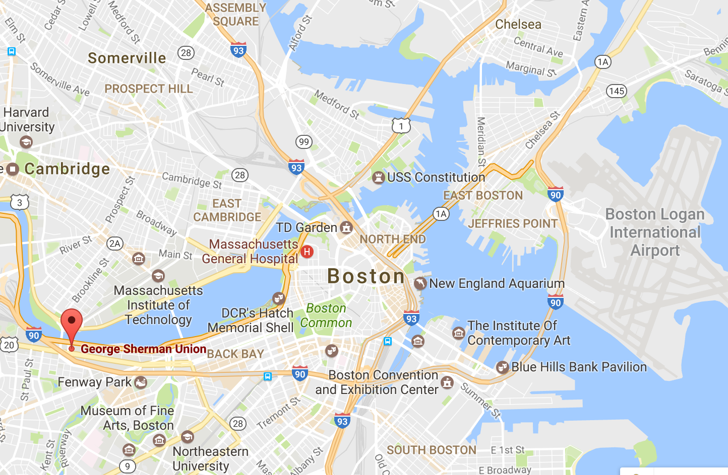
Venue: George Sherman Union (GSU) @ BU
Student union, many food options inside GSU and within half a mile to many restaurants
Centrally located and a minute walk from "T" (subway)
5 minute T ride from central “downtown” Boston with restaurants, shopping, cultural activities

Slide 7
Previous conferences
At GSU
Neutrino 2014 (550 participants) : http://neutrino2014.bu.edu/
Education (350 participants) : https://www.aacu.org/summerinstitutes/hips/2017
Educators Rising (800 participants) : https://www.bu.edu/sed/sed-will-be-a-model-for-educators-rising-collegiate-chapter-at-national-conference/
Other recent events organized by members of the local organizing committee
PIC 2004: http://physics.bu.edu/pic2004/
US ATLAS Workshop 2011: http://physics.bu.edu/sites/atlas-workshop-2011/

Slide 8
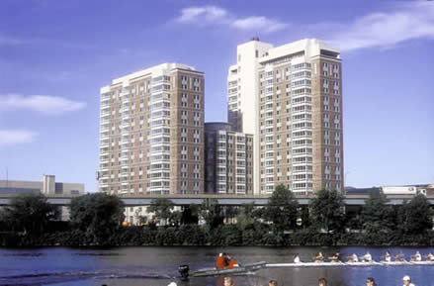
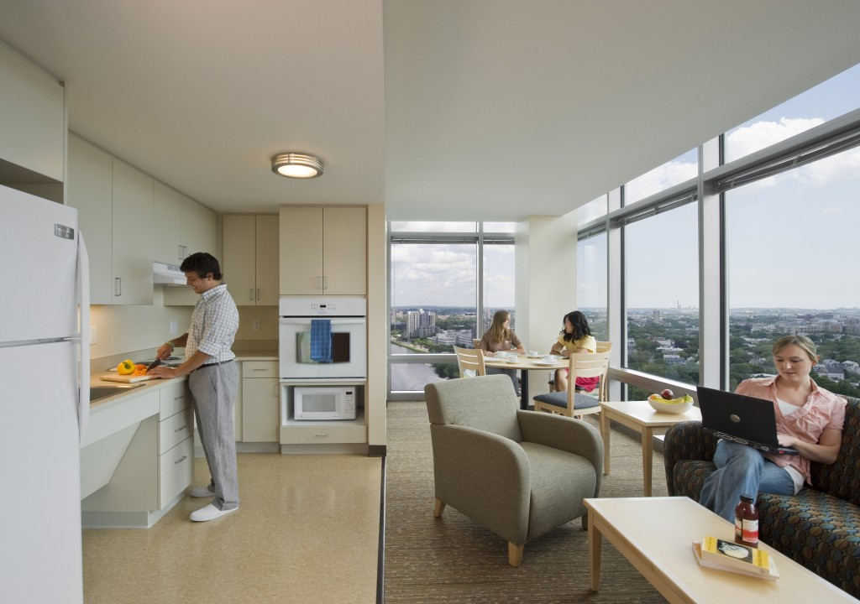
Accommodations: On-campus
Modern, air-conditioned high-rise with 17 residential floors
Reasonably priced: current rate - $86 dollars a night
Apartments have four single-occupancy bedrooms, two bathrooms, a kitchen area, and a living area.
Located a few min walk from conference venue
TVs, irons, iron boards, 24 hour a day coffee/tea service area
A lounge on the top floor has dramatic views of the Charles River, Cambridge, and downtown Boston.
Details at http://www.bu.edu/meetatbu/explore-our-facilities/residence-halls/adult-groups/10-buick-street/

Slide 9
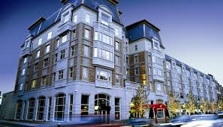
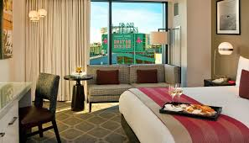
Hotels
Some nearby hotel options:
Holiday Inn (~$120 )
Hotel Commonwealth ~($240)
Buckminster (~$220)
greater Boston area has many 3 and 4 star hotels easily connected by 10 min T ride

Slide 10
Preliminary Meeting Agenda
 | Monday | Tuesday | Wednesday | Thursday | Friday | Saturday
 | 8:30 – 10:30 Registration & Opening Plenary | 9:00 – 10:30 Plenary | 9:00 – 10:30 Plenary | 9:00 – 10:30 Plenary | 9:00 – 10:30 Plenary | 9:00 – 10:30 Plenary
 | 10:30 – 11:00 Coffee Break | 10:30 – 11:00 Coffee Break | 10:30 – 11:00 Coffee Break | 10:30 – 11:00 Coffee Break | 10:30 – 11:00 Coffee Break | 10:30 – 11:00 Coffee Break
 | 11:00 – 12:30 Plenary | 11:00 – 12:30 Parallel | 11:00 – 12:30 Parallel | 11:00 – 12:30 Parallel | 11:00 – 12:30 Parallel | 11:00 – 12:30 Closing Plenary
 | 12:30 – 14:00 Lunch | 12:30 – 14:00 Lunch | 12:30 – 14:00 Lunch | 12:30 – 14:00 Lunch IAC Meeting | 12:30 – 14:00 Lunch | Adjourn
 | 14:00 – 16:00 Parallel | 14:00 – 16:00 Poster | Excursions | 14:00 – 16:00 Parallel | 14:00 – 16:00 Parallel
 | 16:00 – 16:30 Coffee Break | 16:00 – 16:30 Coffee Break |  | 16:00 – 16:30 Coffee Break | 16:00 – 16:30 Coffee Break
 | 16:30 – 18:30 Parallel | 16:30 – 18:30 Plenary |  | 16:30 – 18:30 Plenary | 16:30 – 18:30 Plenary
 | 18:30 - 20:30 Reception | 18:30-19:30 Panel Discussion |  | 20:00 - 21:30 Dinner | 19:30 – 21:30 Public lecture + Career Panel

Slide 11
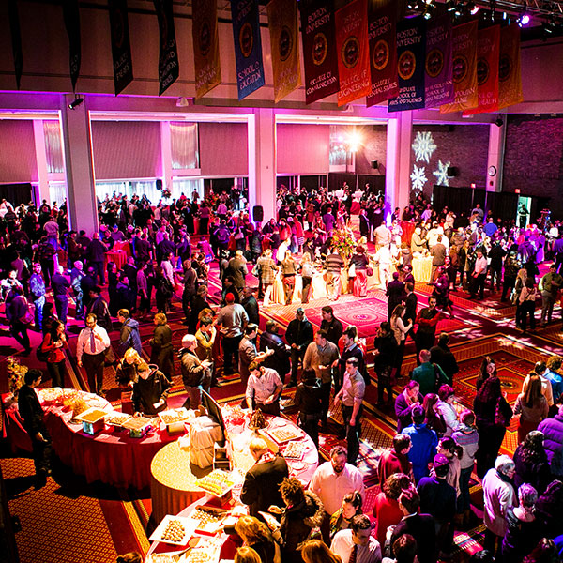
Social Program
Day 1:
Welcome reception
just outside GSU
(Drinks, appetizers)

Slide 12
Day 3: Excursions
Many options that participants could choose from:
Whale Watching
Boston Ducktour

Slide 13
Day 3: Excursions
Many options that participants could choose from:
Baseball shrine:
Fenway Park
Freedom trail of historic Boston

Slide 14
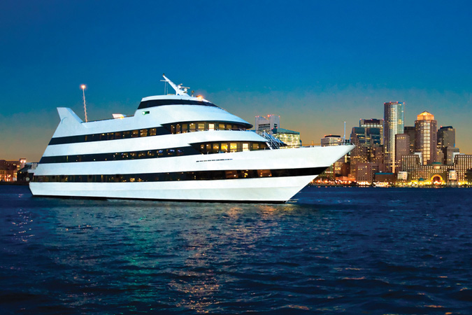
Day 4: Conference Dinner
Possible options:
3 or 4 hour cruise of the Boston harbor
Boston Aquarium
Museum of Fine Arts

Slide 15
Other Events
Day 2 evening: Panel discussion on enhancing diversity and participation of under-represented minorities in Physics
Day 5 evening:
Public lecture:
Plan to invite a prominent physicist (many in the Boston area) to give a public lecture
Career Panel:
Plan to invite speakers from diverse career paths (e.g. academic, industry and government)

Slide 16
Registration
Registration fee: ~$500 / person, $300 for students
The registration fee will cover the cost of conference rooms, equipment rental, conference materials, coffee breaks, 5 lunches, 1 reception, 1 conference dinner.
participants to pay for excursions separately
Accompanying person cost: $150 (reception, banquet). Lunch tickets can be purchased separately.
Will apply for funding for providing financial support to limited number of participants to further decrease costs
Potential sponsors: DOE, NSF, CERN, Fermilab, Brookhaven, Boston University

Slide 17
Local Organizing Committee
Kevin Black (Boston University - ATLAS): co-chair
Tulika Bose (Boston University - CMS): co-chair
John Butler (Boston University - ATLAS)
Kenneth Lane (Boston University - Collider Theory)
Jim Rohlf (Boston University - CMS)
Larry Sulak (Boston University - CMS): sponsor contact

