Slide 1
Today Week 6: + feedback w/ Op Amps; FET Switches; Schmidt; S/H: H&H L10&11 Mon Mar 2
FOCUS on required Labs: 10-1, 2, 3 or 4, 7;
A. 11-1a), 11-1 B., 2, 3, 5;
Skim pp. 207-266: Use IRF 520 (vs 510) & rotate “spade” pins along axis by 90°.
Supply all pins of DG403 analog switch!!! see p259
OP-AMP as amplifier: a reprise typical voltage gain > 10,000, with biasing done for you = an impedance matcher: >>MΩ looking in input, <1Ω into output (Thevenin) gains determined by 2 external resistors. dc operating “sweet” spot done for you. ± 15v rails, with both op amp inputs “virtually” sitting at ground no C_{input} or C_{output} blocking of DC bias needed constant gain up to HF, temperature independent, highly linear output dynamic range (compliance)...symmetric saturation at rails distortion only when approaching slew rate...e.g. ~5 v/μsec, ~MHz Input dynamic range limited by enormous gain 2 Golden “ideal rules”: input voltage diff = 0 v, input current = 0 ma each has its limitations 2 classic configurations: inverting & non-inverting modify in innumerable ways with non-linear external “hair”
Iff you have negative feedback!
Today we explore +POSITIVE+ feedback
Before you leave each day, please be sure to stop me & show me what you’ve achieved!

Slide 2
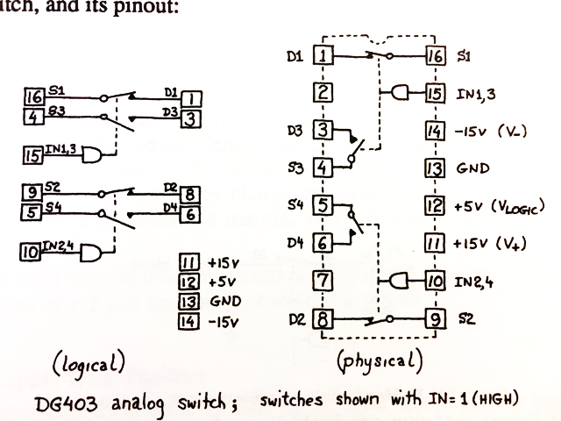
All pins must be tied down for it to work right!!! (except manufacture’s test, 2 & 7)

Slide 3
FET’s: 2 flavors
JFET pnp, npn (pn) Junction FET, not used much these days
MOSFET Metal-Oxide-Semiconductor FET, thousands in every digital chip cf. 2N5485
p or n-type Si to form a conductive channel between source & drain on “substrate”
doped with B or Ph
heated in H2O vapor to form thin SiO2 insulator on surface
Al evaporated and deposited to form metal “gate”
run in enhancement mode: + gate attracts electron carriers in channel
- gate attracts “hole” carriers
a controllable current source, a 0Ω resistance switch with hi Z_{in}
an analog switch for current traveling in either direction, S to D, or D to S ...not a pn junction, which has directionality
10k electrons on gate can switch 1 amp!
CMOS Complementary...p-channel and n-channels on same chip allow push-pull
digital computer logic, +5v = “on”, 0v = “off”, switches analog signals up to ± 15v rails
MOSFET natural figure of merit:
transconductance (g_{m}) = ΔI_{out} / ΔV_{in} in micro-mho (mho = ohm⁻¹ = 1/ohm, Ω upside down)
(used also for pentodes, the 5 element vacuum tube equivalent) pix p157
MOSFET Defects and Limitations:
charge injection = switching “on” or “off”, ~60 pC of charge spit out to drain (Coulombs)
feedthrough = dB of signal on gate that gets through to the drain due to stray (10pF)
R_{on} = non-zero Drain to Source resistance R_{DS} when turned on...ideally 0Ω (~25Ω)
rf limitations: stray capacitance, at input: C_{GD} & C_{GS} & at output: C_{DG} & C_{DS} pixs p265

Slide 4
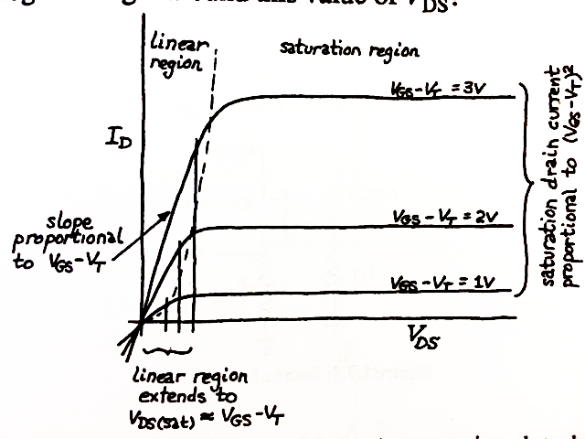

Slide 5
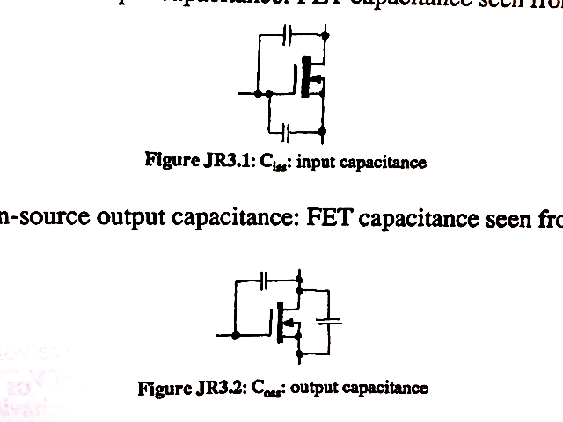

Slide 6
SCHMITT TRIGGER and SAMPLE & HOLD...the 2 most important analog chips
OP AMP INNARDS
diff amps, current mirrors, push pull emitter followers pix p232
often with open-collector outputs...you select it externally with pull-up resistor
SCHMITT TRIGGER schematic p235
threshold to go “on” is higher than to go “off” = hysteresis
i.e. a discriminator LF311
= fast op amp with positive feedback 2 threshold diagram
SAMPLE & HOLD
samples a voltage, stores it, let’s it be digitized
¼ pc least count...4x stray capacitance + charge injection
S&H natural figures of merit:
acquisition time...how long to charge up sampling capacitor?
determines S&H speed (~μsec)
droop rate...how fast does the charge on the capacitor leak off?
FET Defects and Limitations
charge injection = each time switch on or off, ~60pC of charge spit out to drain (Coulombs)
LEDs...Si, GaAs, GaInPh

Slide 7
Mon, Mar 16, “must” skim H&H 281-341, focus on L13 & 14 & your Arduino: Digital Electronics: gates, binary logic with NANDs, Flip Flops…logic probes.
During Spring Break...
Prepare for Labs 13-1, 2, 4, 5, but no TTL; Labs 14-1, 2, 5-b
Take your Arduino microprocessor & cable home: you must bring your laptop with Arduino to lab.
Read Eric Hazen’s page for the minimal C you must know:
https://docs.google.com/document/d/1dNcLgDqVa4kXvEaW8MCvMPSsF3m3jEKtGxN8k60e8-o/edit
Follow Dan Gastler’s “Crash Course in C” lecture slides:
https://docs.google.com/presentation/d/18sV6cQqeDFwiH5KBWFixevLTHqkzHcVgzM-WMMHFghs/edit?usp=sharing
Download Arduino software to your laptop; do the “blink” tutorial at
http://arduino.cc/en/Tutorial/Foundations
Prepare for 45 min analog written exam (it’ll be easy) during that session, at 10:10
(11am if a class conflict at that time. )

