Slide 1
Organic Semiconductors: Electronic Properties and Optoelectronic Applications
Hsiang-Han Tseng

Slide 2
Overview
Organic Semiconductors
Electronic Properties
Fundamentals of Organic PV Cells
Examples

Slide 3
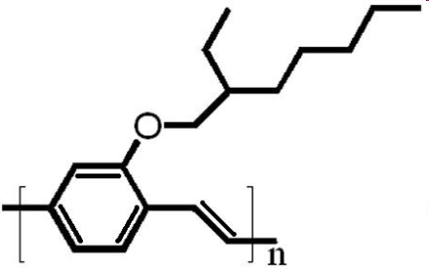
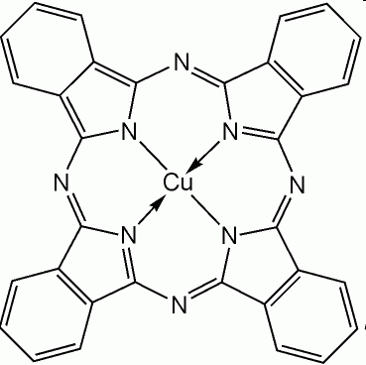
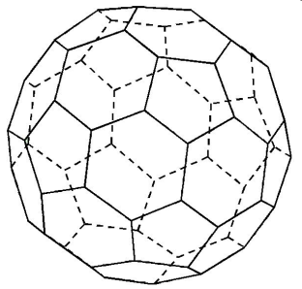

Organic Semiconductors
Polymers
Small molecules
Characteristics: highly conjugated system, such as aromatic, or conjugated π bonds
Categories: according to their molecular weight, they can be classified as 1. small molecules or 2. polymers

Slide 4
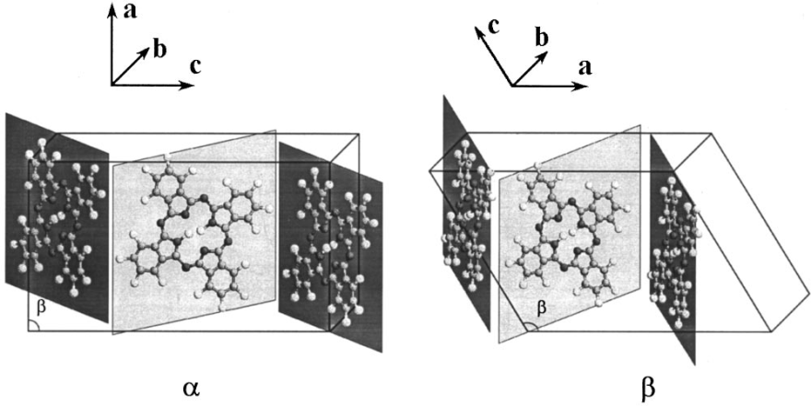
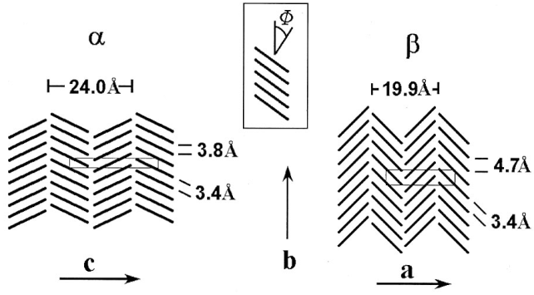
Small Molecules
Examples: phthalocyanines (Pcs) and PTCDA.
In thin films, they form molecular crystals, and exhibit unique properties different from inorganic semiconductors, e.g. transport properties.
S. Yim et al J. Appl. Phys., Vol. 91, No. 6, 3632, (2002)

Slide 5
Electronic Structure and Properties
Localisation
– Inorganic: highly delocalised Bloch states moving in energy band
– Organic: highly localised states on individual polymer chains or molecules
Exciton
– Inorganic: Wannier
– Organic: Frankel
Wannier
Charge-Transfer
Frankel

Slide 6
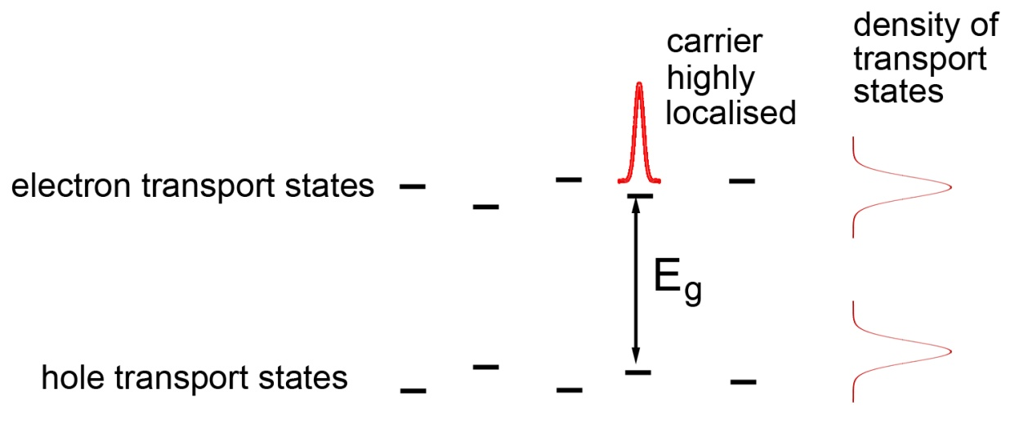
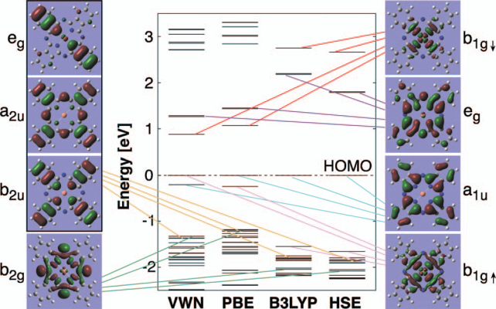
Charge transport via hopping mechanism
Marom et al. J. Chem. Phys. 128, 164107 2008

Slide 7
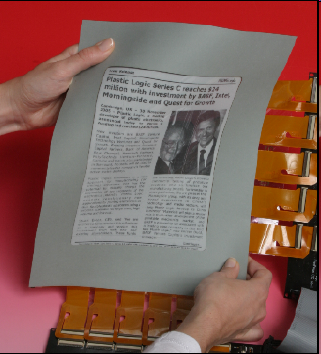
Advantages of Organic Materials
Organics are cheap
Versatile, which allow us to tune the optical properties
Fabrication on large scale is straightforward
Low cost
Save resources
S. R. Forrest Nature, 428, 29, 911 (2004)
Plastic Logic OLED Journal

Slide 8
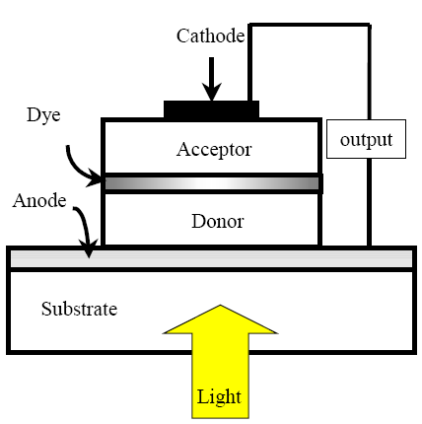
Fundamentals of Organic PV Cells
Three key steps:
1. Light absorption and creation of excitons
2. Exciton migration and dissociation
3. Charge collection
J. Nelson, Curr. Opin. Solid State Mater. Sci.6, 87-95 (2002)

Slide 9
Requirements for successful PV cells:
1. Price
2. Energy conversion
Approaches:
1. Novel materials
2. Note that morphology of the film plays a significant role in thin film devices – A trade off between exciton dissociation and mobility
3. Device architecture
4. Contact

Slide 10
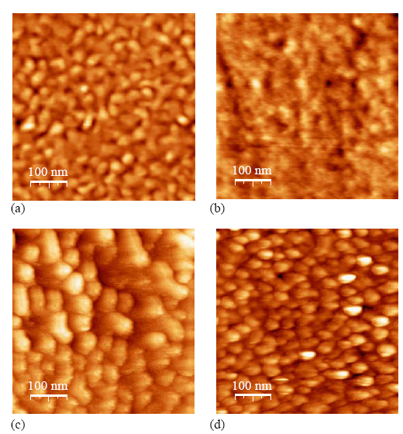
Examples
Bulk heterojunction of CuPc/C₆₀ – the electronegative C60 functions as a good acceptor
Y. Fang et al ,Nano.2,5 1002-32 (2008)
Other carbon allotropies e.g. carbon nanotubes and graphene have been utilized
S. Heutz et al,
Sol. Energy. Mat. &Sol. Cells 83 (2004) 229–245
Z. Liu et al, Adv. Mater. 2008, 20, 3924–3930

Slide 11
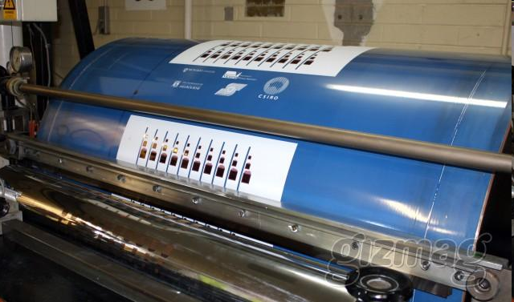
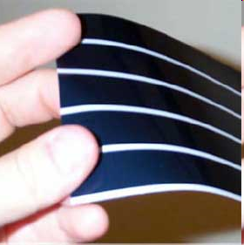
Conclusion
Low production cost, easy and straightforward fabrication make organic semiconductors as a good candidate for electronic and optoelectronic applications
Problems need to be solved – Lifetime, degradation, ability to absorb more sunlight

Slide 12
Thank you for your attention.

