Slide 1




Nonequilibrium dynamics near quantum phase transitions
Anatoli Polkovnikov,
Boston University
Roman Barankov BU
Ryan Barnett NIST
Christian Gogolin Wurzburg
Claudia De Grandi BU
Vladimir Gritsev U. of Fribourg
Ludwig Mathey NIST
Mukund Vengalattore Cornell
Princeton University. Condensed Matter Seminar, 03/29/2010

Slide 2
Plan of the talk
Adiabatic dynamics near quantum critical points. Universal non-linear response.
Connection between quantum and thermodynamic adiabatic theorems. Three regimes of non-adiabaticity.
Thermalization in closed systems. Microscopic expressions for heat and entropy.
Quench dynamics in XY-model. Time evolution as a renormalization group process.

Slide 3
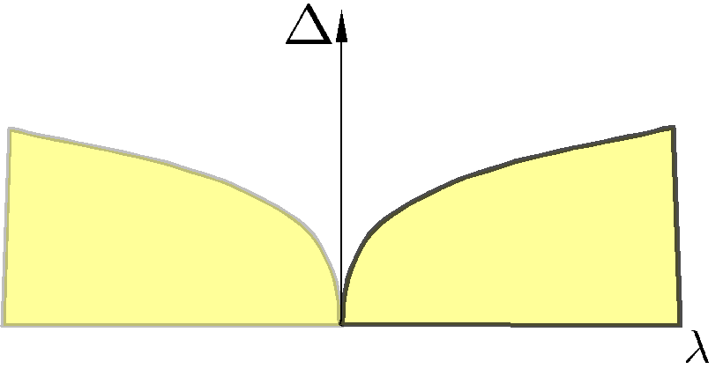


Quantum phase transitions in a nutshell.
susceptibility
Equilibrium properties of the system are universal near critical points (both classical and quantum).
What can we say about non-equilibrium dynamics?

Slide 4
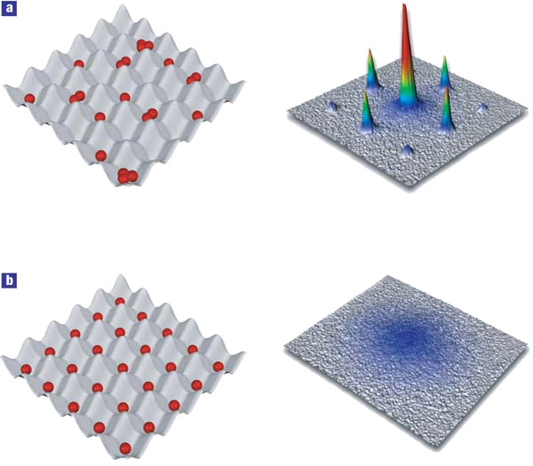
Motivation: cold atoms. Isolated interacting systems with controllable (tunable) Hamiltonians.
Superfluid insulator phase transition in an optical lattice
Greiner et. al. 2002

Slide 5
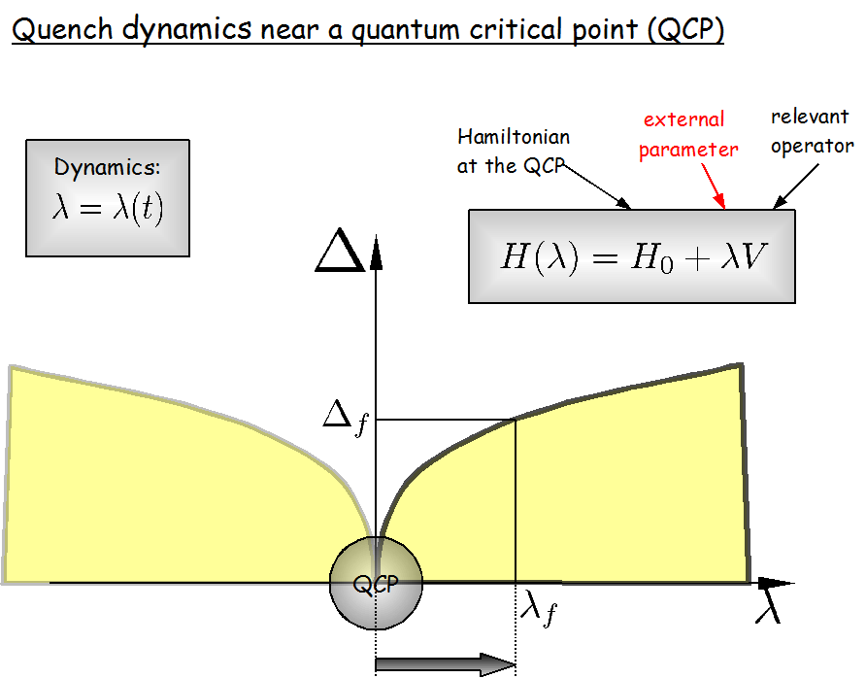

Slide 6
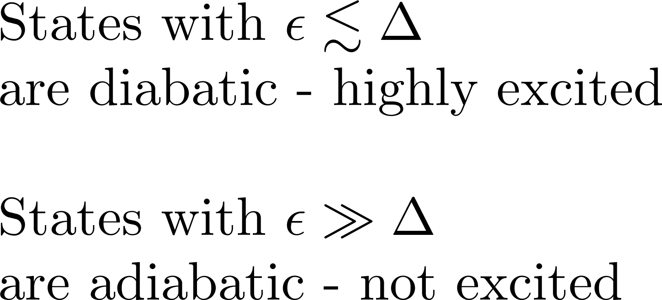
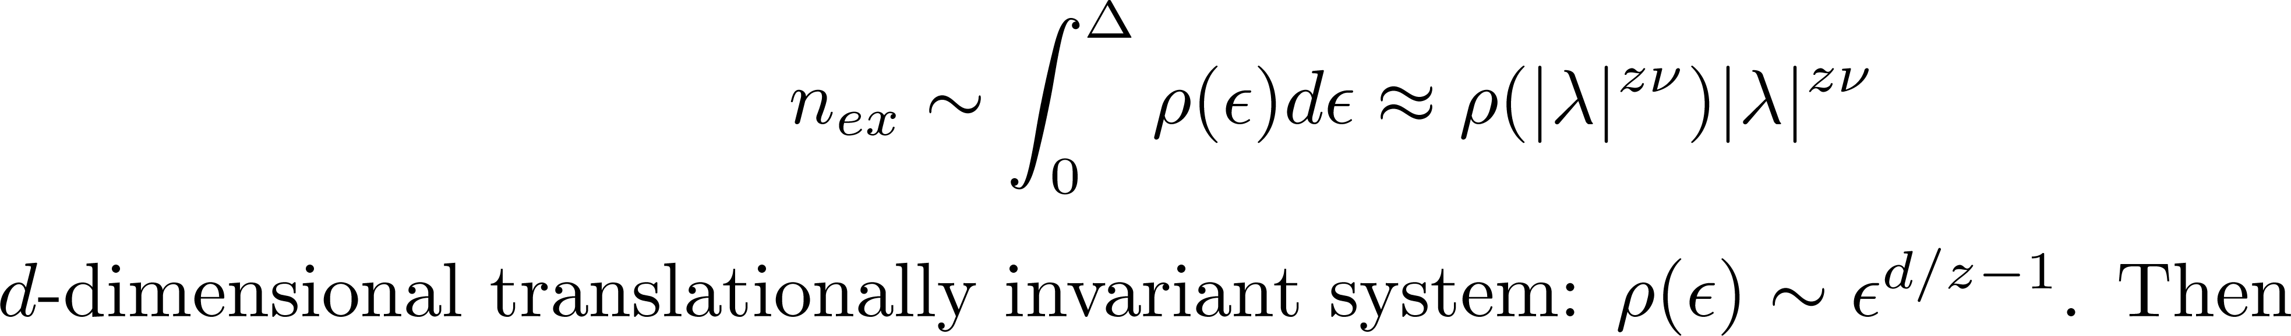
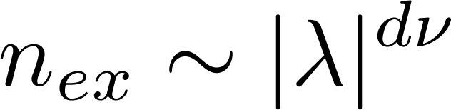
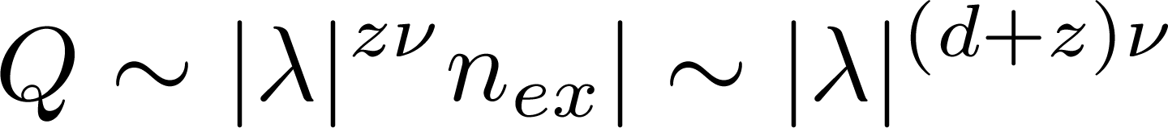
Excess energy = energy above new ground state (=heat)

Slide 7
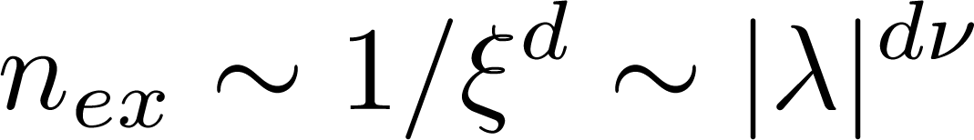
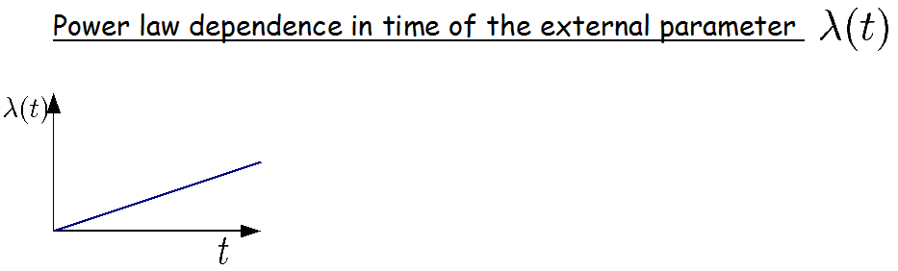
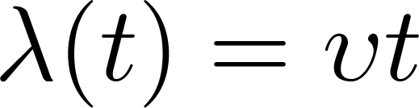
Alternative explanation.
Ordered phase
Disordered phase
The system is not adiabatic near QCP.

Slide 8
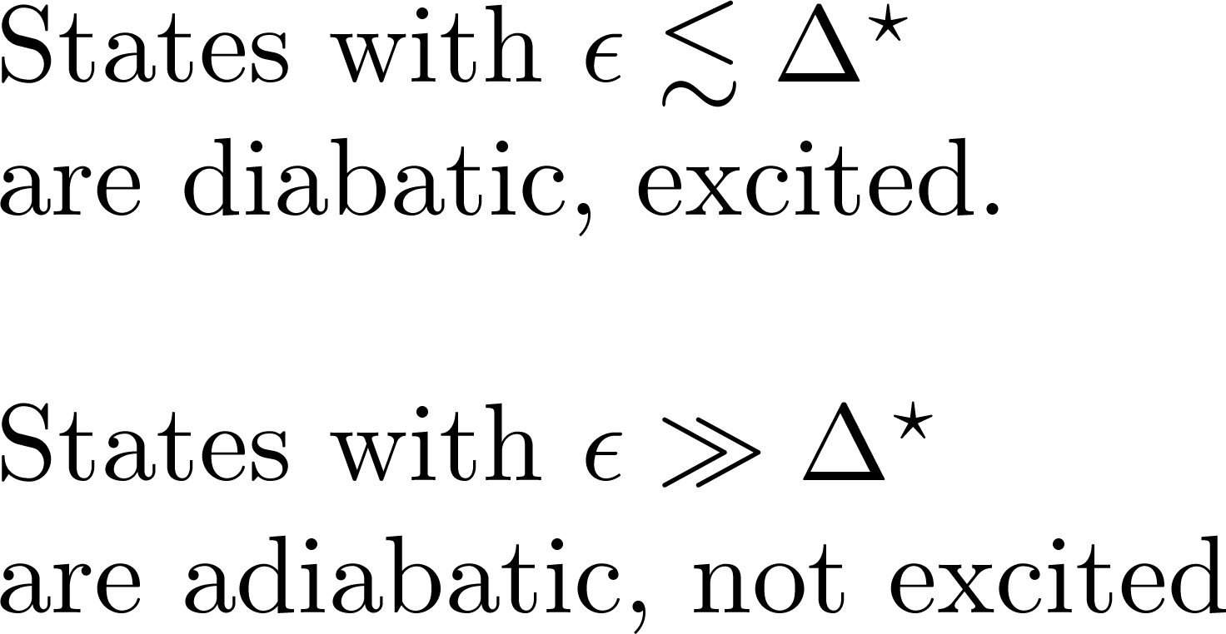
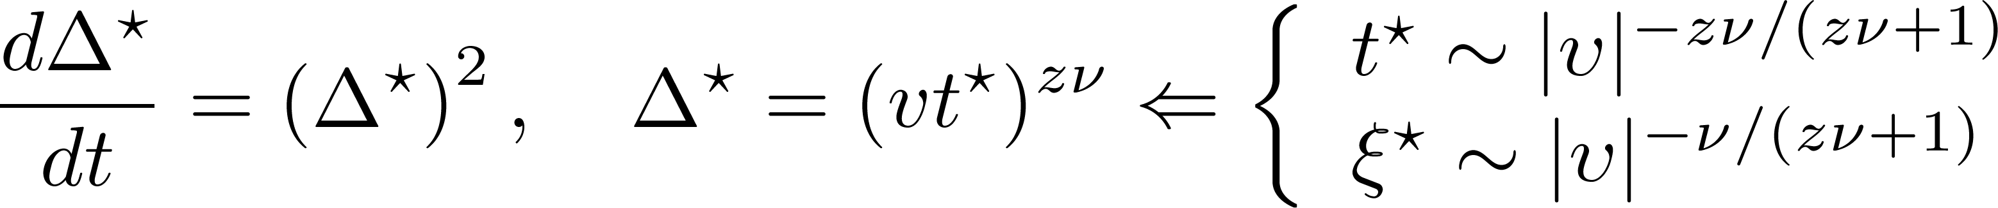
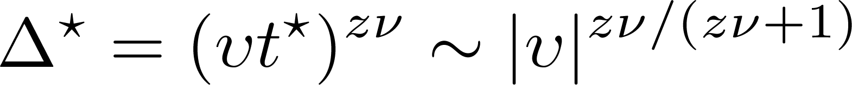
Use Landau-Zener criterion
A.P. 2003,
Zurek, Dorner, Zoller 2005

Slide 9
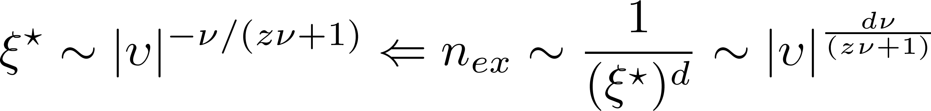
Classical Kibble-Zurek mechanism

Slide 10
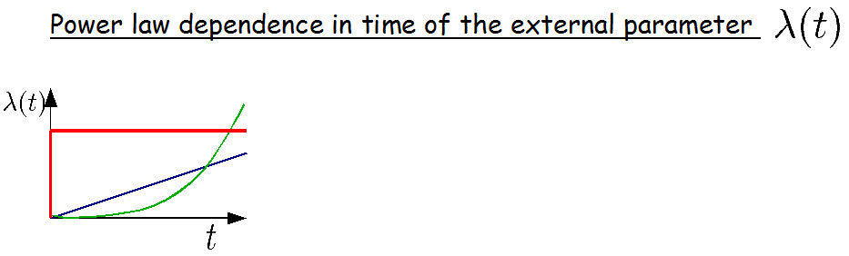
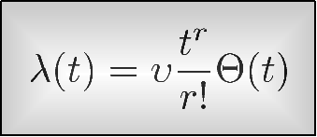
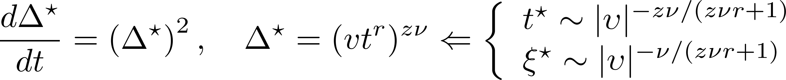
Arbitrary power law quench.
Use the same argument

Slide 11
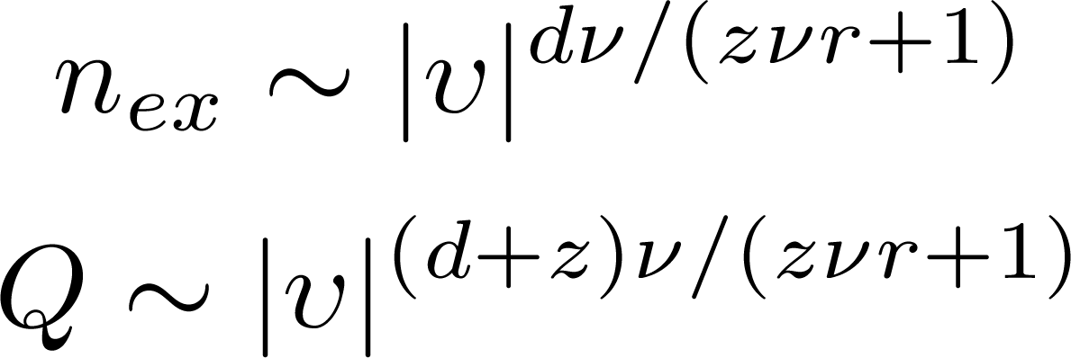
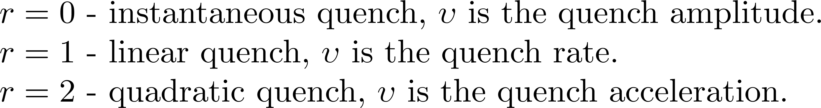
The scalings suggest usability of the adiabatic perturbations theory: small parameter - proximity to the instantaneous ground state.
Non-analytic scalings are usually related to singularities in some susceptibilities. Need to identify the relevant adiabatic susceptibility.

Slide 12
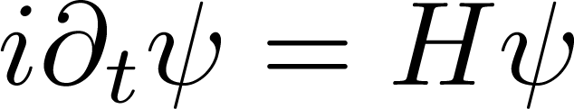
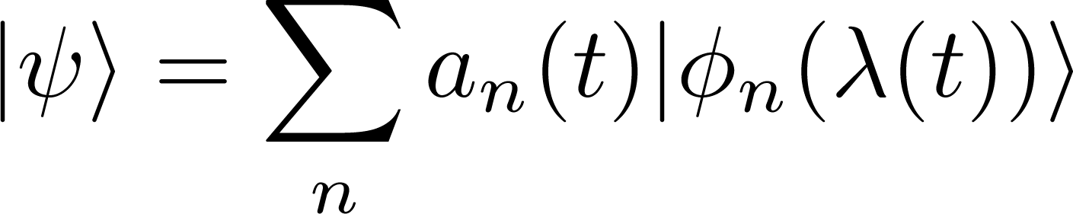
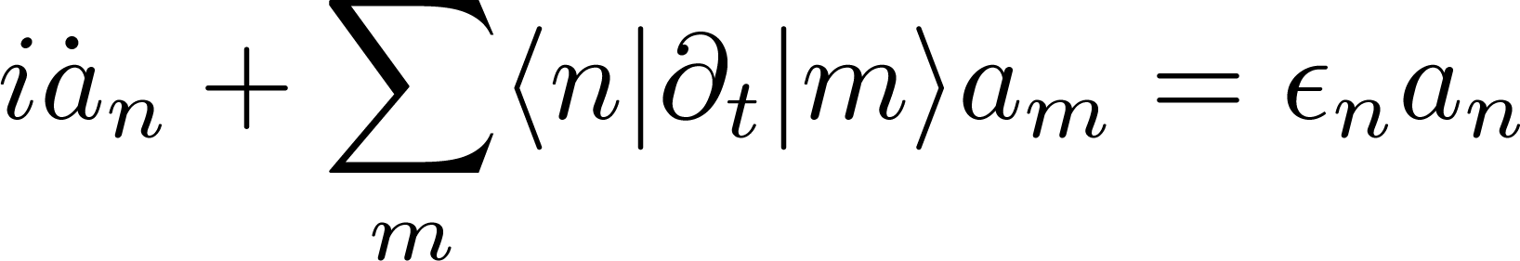
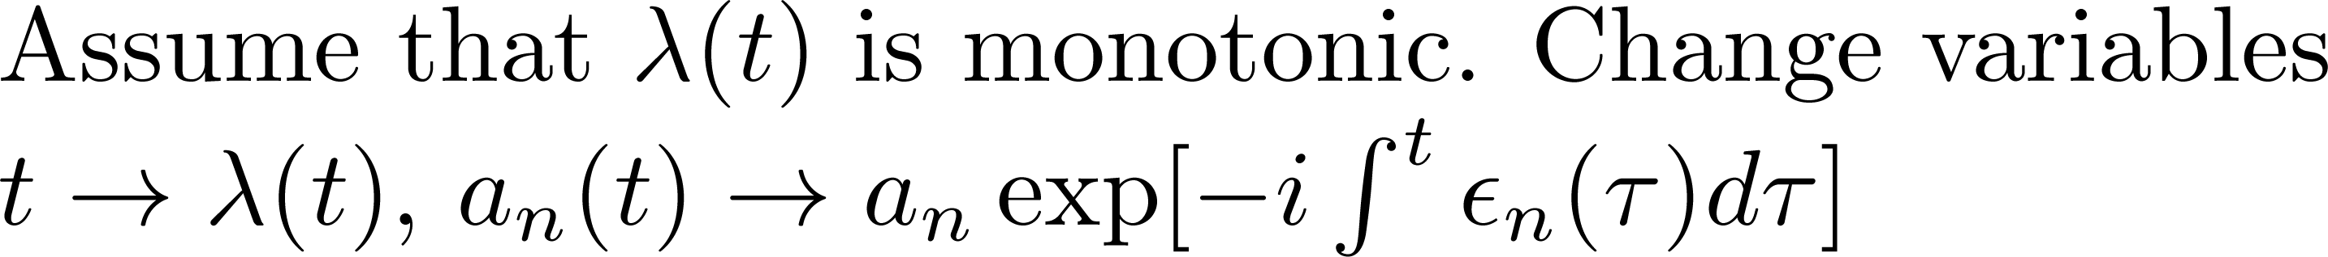
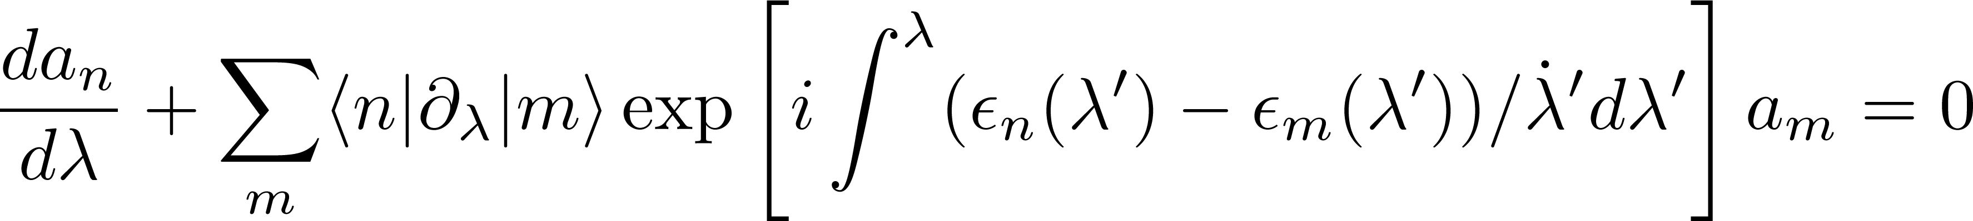
Kibble-Zurek scaling through adiabatic pertubation theory.
Expand wavefunction in the instantaneous energy basis
Time is like an external a parameter!

Slide 13
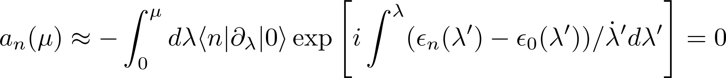
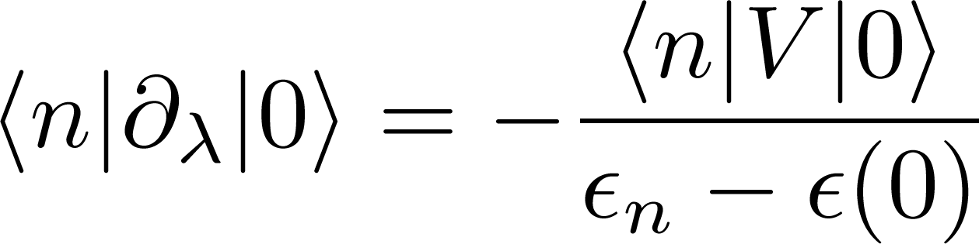
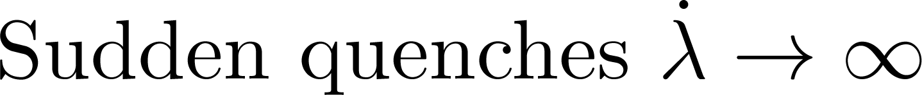
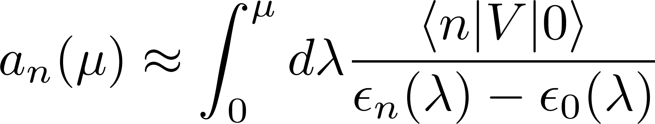
Reduces to the symmetrized version of the ordinary perturbation theory.

Slide 14
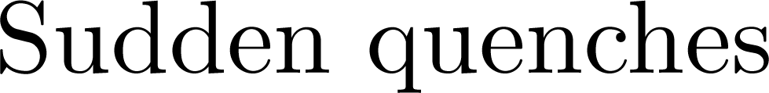
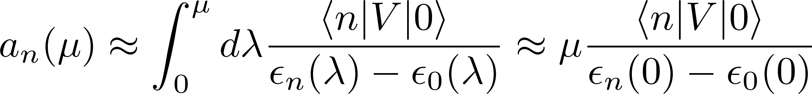
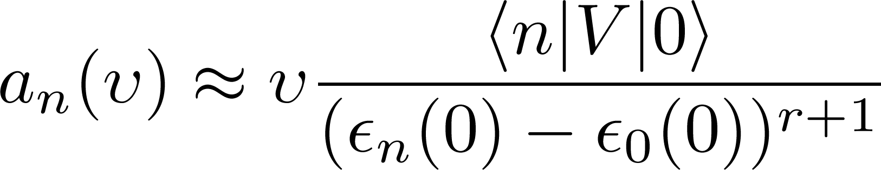
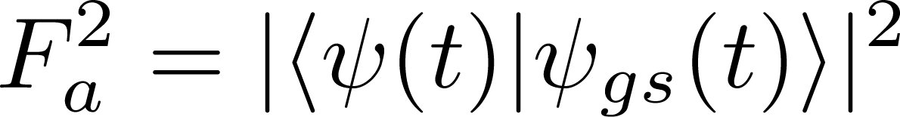
Perturbative regime
Define adiabatic fidelity:

Slide 15
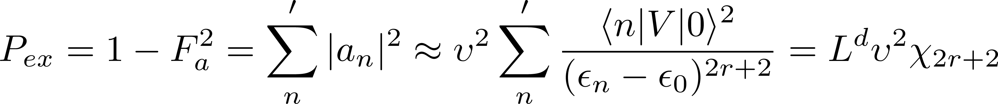
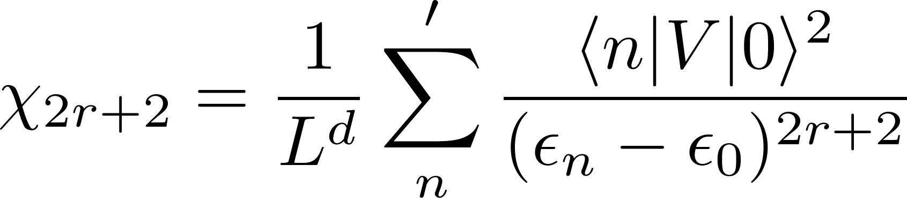
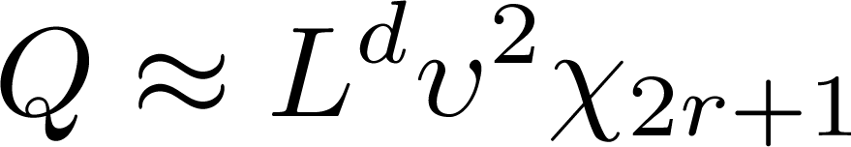
Probability of exciting the system
Where

Slide 16
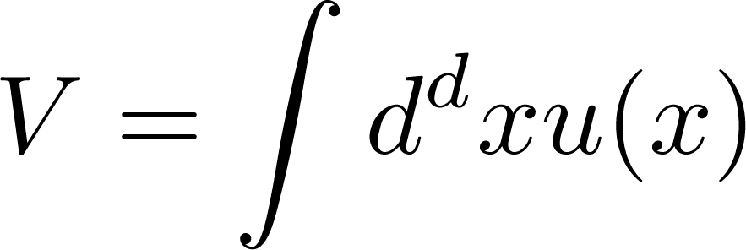
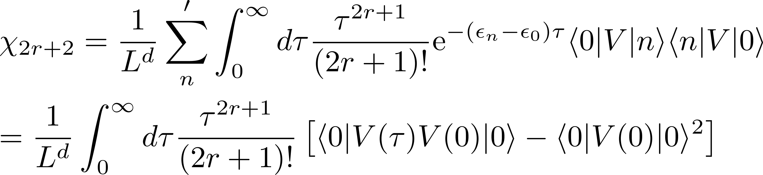
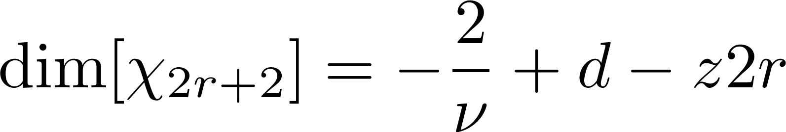
“Fluctuation-dissipation” relation for the fidelity

Slide 17
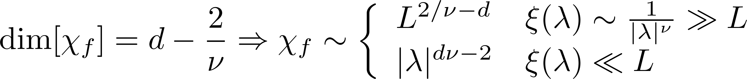
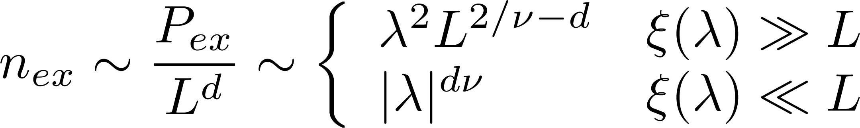
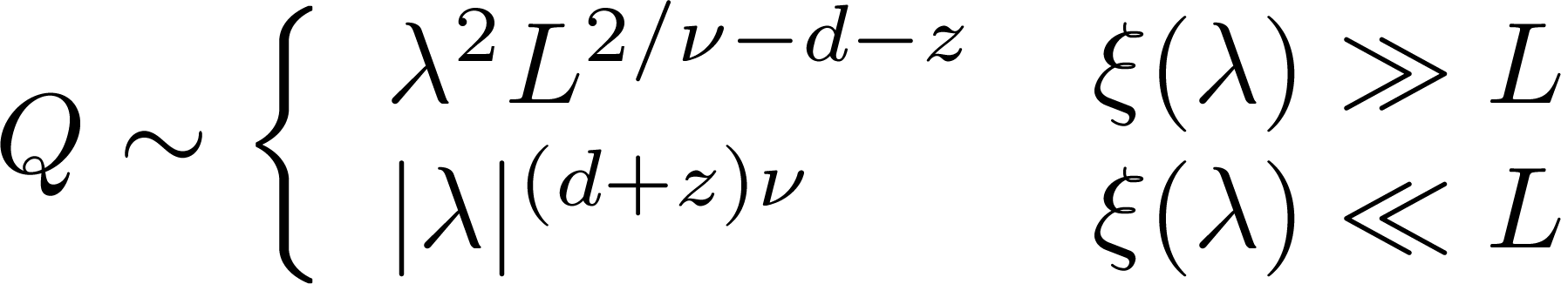
Sudden quenches
Heat

Slide 18
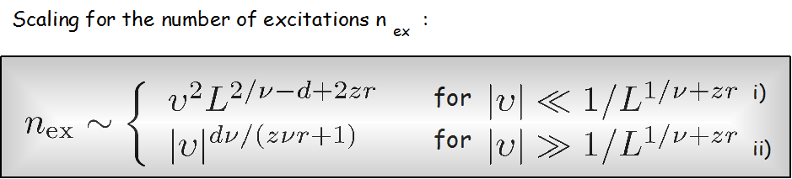
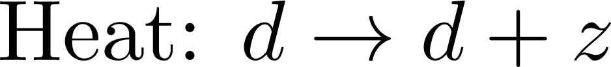
General scaling results
Main conclusion: quantum Kibble-Zurek scaling and its generalizations are associated with singularities in the adiabatic susceptibilities describing adiabatic fidelity.

Slide 19
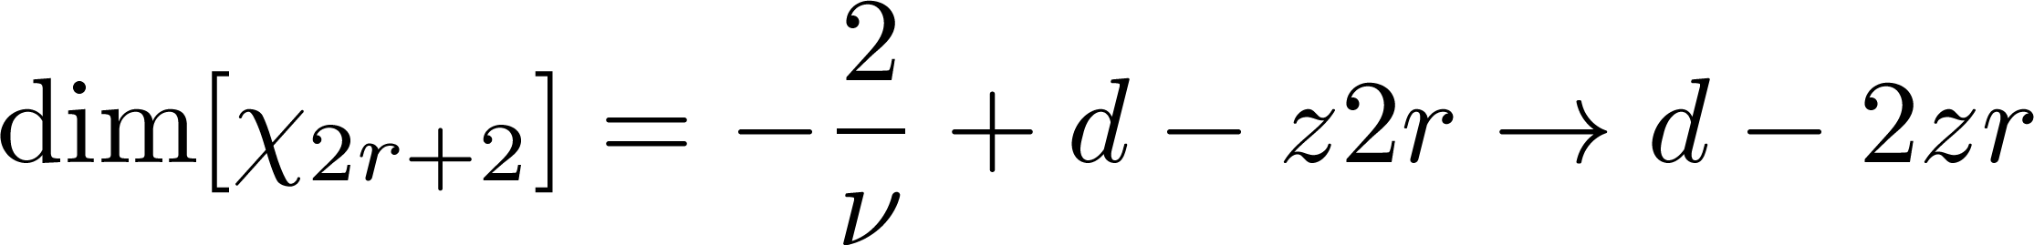
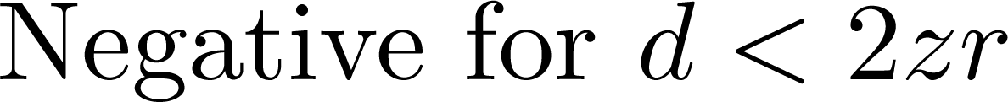
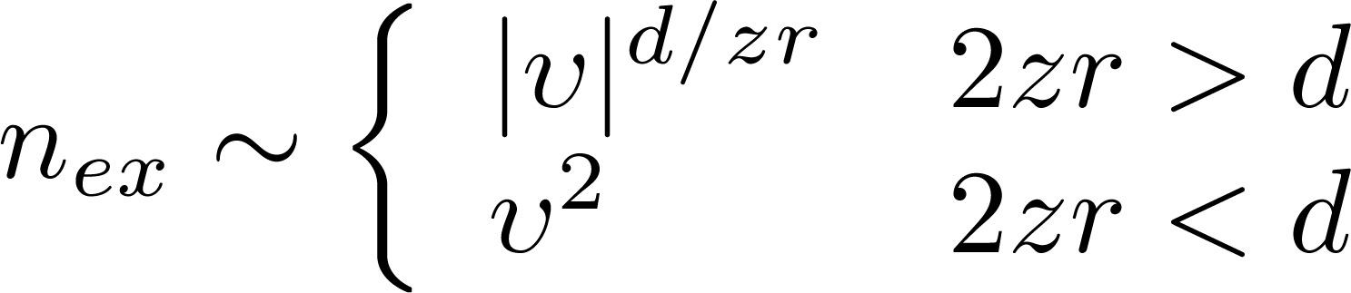
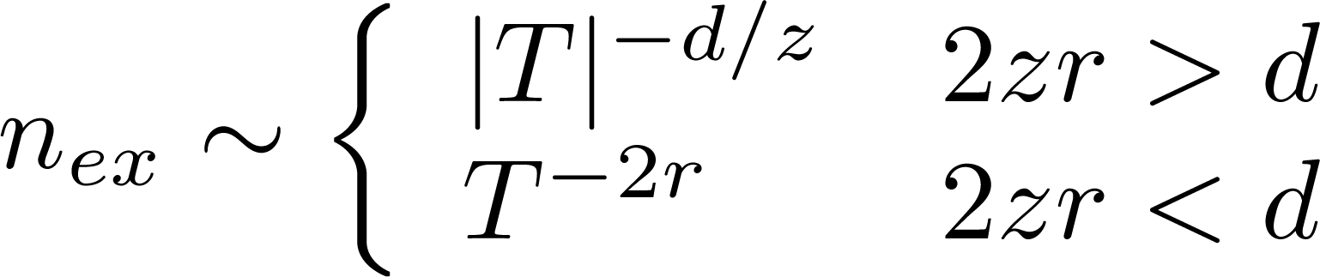
Non-critical gapless phases (send ν to ∞)
(Martin Eckstein, Marcus Kollar, 2008)

Slide 20
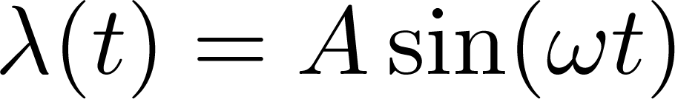
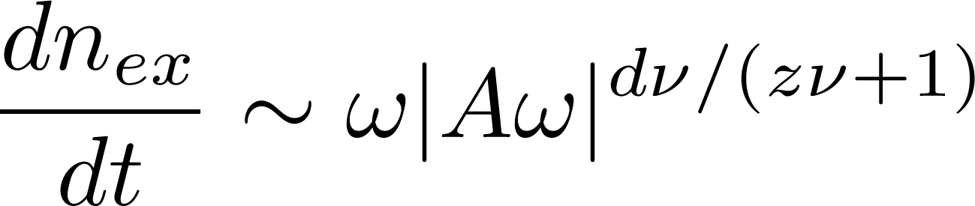
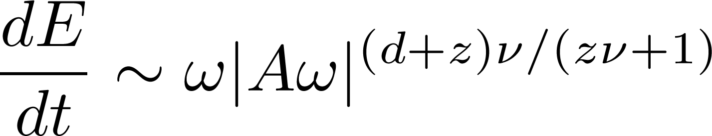
Speculation – universal nonlinear response near QCP
Main source of quasi-particle and entropy production – vicinity of the QCP. Only slope is important.

Slide 21
Thermalization in classical systems (origin of ergodicity): chaotic many-body dynamics implies exponential in time sensitivity to initial fluctuations.
Thermalization in quantum systems (EoM are linear in time – no chaos?)
Consider the time average of a certain observable A in an isolated system after a quench.
Eignestate thermalization hypothesis (Srednicki 1994; M. Rigol, V. Dunjko & M. Olshanii, Nature 452, 854 , 2008.): A_{n,n}~ const (n) so there is no dependence on ρ_{nn}.
Information about equilibrium is fully contained in diagonal elements of the density matrix.

Slide 22
Information about equilibrium is fully contained in diagonal elements of the density matrix.
This is true for all thermodynamic observables: energy, pressure, magnetization, …. (pick your favorite). They all are linear in ρ.
This is not true about von Neumann entropy!
Off-diagonal elements do not average to zero.
The usual way around: coarse-grain density matrix (remove by hand fast oscillating off-diagonal elements of ρ.
Problem: not a unique procedure, explicitly violates time reversibility and Hamiltonian dynamics.

Slide 23
Von Neumann entropy: always conserved in time (in isolated systems). More generally it is invariant under arbitrary unitary transfomations
Thermodynamics: entropy is conserved only for adiabatic (slow, reversible) processes. Otherwise it increases.
Quantum mechanics: for adiabatic processes there are no transitions between energy levels:
If these two adiabatic theorems are related then the entropy should only depend on ρ_{nn}. Simple resolution:
the sum is taken in the instantaneous energy basis.
???

Slide 24
Connection between two adiabatic theorems allows us to define heat (A.P., Phys. Rev. Lett. 101, 220402, 2008 ).
Consider an arbitrary dynamical process and work in the instantaneous energy basis (adiabatic basis).
Adiabatic energy is a function of state.
Heat is a function of process.
Heat vanishes in the adiabatic limit. Now this is not the postulate, this is a consequence of the Hamiltonian dynamics!

Slide 25
Isolated systems. Initial stationary state.
Unitarity of the evolution:
In general there is no detailed balance even for cyclic processes (but within the Fremi-Golden rule there is).

Slide 26
yields
If there is a detailed balance then
Heat is non-negative for cyclic processes if the initial density matrix is passive . Second law of thermodynamics in Thompson (Kelvin’s form).
The statement is also true without the detailed balance but the proof is more complicated (Thirring, Quantum Mathematical Physics, Springer 1999).

Slide 27
Properties of d-entropy (A. Polkovnikov, arXiv:0806.2862. ).
Jensen’s inequality:
Therefore if the initial density matrix is stationary (diagonal) then
Now assume that the initial state is thermal equilibrium
Let us consider an infinitesimal change of the system and compute energy and entropy change.

Slide 28
Recover the first law of thermodynamics (Fundamental Relation).
If λ stands for the
volume the we find

Slide 29
Classic example: freely expanding gas
Suddenly remove the wall
by Liouville theorem
double number of occupied states
result of Hamiltonian dynamics!

Slide 30
Classical systems.
Instead of energy levels we have orbits.
probability to occupy an orbit with energy E.
describes the motion on this orbits.
Classical d-entropy
The entropy “knows” only about conserved quantities, everything else is irrelevant for thermodynamics! S_{d} satisfies laws of thermodynamics, unlike the usually defined

Slide 31



Measuring (diagonal) entropy (in progress with C. Gogolin).
Smooth narrow energy distribution:
Practical (measurable) definition of non-equilibrium entropy.

Slide 32


Entropy as a measure of non-adiabaticity
Universal. Not dependent on the choice of observable. Not intensive. Unity unless rate vanishes in the thermodynamic limit.
Universal. Intensive: well defined in thermodynamic limit. Depends on knowing structure of excitations. Ill defined in non-integrable systems.
Universal. Intensive. Measurable. Not easy to separate from adiabatic energy. Not-universal unless end exactly at the critical point.
Universal. Intensive. Sensitive only to crossing QCP (not where we start (end) the quench. (not) Measurable.

Slide 33
Thermodynamic adiabatic theorem.
In a cyclic adiabatic process the energy of the system does not change: no work done on the system, no heating, and no entropy is generated .
General expectation:
- is the rate of change of external parameter.

Slide 34
Adiabatic theorem in quantum mechanics
Landau Zener process:
In the limit δ → 0 transitions between different energy levels are suppressed.
This, for example, implies reversibility (no work done) in a cyclic process.

Slide 35
Adiabatic theorem in QM suggests adiabatic theorem in thermodynamics:
Transitions are unavoidable in large gapless systems.
Phase space available for these transitions decreases with the rate. Hence expect
Taylor expansions do not always work. Especially in low dimensions because of high density of low energy states.
Can expect breakdown of Taylor expansion in low dimensions, especially near QCPs.

Slide 36
Three regimes of response to the slow ramp:
A.P. and V.Gritsev, Nature Physics 4, 477 (2008)
Mean field (analytic) – high dimensions:
Non-analytic – low dimensions, near singularities like QCP
Non-adiabatic – low dimensions, bosonic excitations
In all three situations quantum and thermodynamic adiabatic theorem are smoothly connected.
The adiabatic theorem in thermodynamics does follow from the adiabatic theorem in quantum mechanics.

Slide 37


Landau-Zener problem
Now start t_{i}→ -∞, t_{f} – finite (or vice versa)
For finite interval of excitation the transition probability scales as the second power of the rate (not exponentially).

Slide 38
Example: loading 1D condensate into an optical lattice or merging two 1D condensates
(C. De Grandi, R. Barankov, AP, PRL 2008 )
K – LL parameter
Relevant sine
Gordon model:

Slide 39
Results:
K=2 corresponds to a SF-IN transition in an infinitesimal lattice (H.P. Büchler, et.al. 2003)

Slide 40
Probing quasi-particle statistics in nonlinear dynamical probes.
T
T>0
Less adiabatic
More adiabatic
T=0
0
bosonic-like
fermionic-like
1
K
transition?
massive fermions
(hard core bosons)
massive bosons

Slide 41
Dynamics as an RG process (with L. Mathey, PRA 2010).
In quantum mechanics relaxation is like an RG process where high frequency modes are gradually eliminated.
Idea: gradually average over high momentum non-interacting modes and follow time evolution of the remaining low energy modes.

Slide 42
Decoupling of two 2D superfluids (with L. Mathey):
L. Mathey, A. P., arXiv:1001.0098
Short times: system relaxes to a steady state with algebraic order.
Long times – vortex anti-vortex pairs start to emerge and can unbind.

Slide 43




Looks like KT transition in real time. How do we describe it analytically?

Slide 44

Need to solve nonlinear Hamiltonian equations of motion:
Idea: split p and θ into low-momentum and high momentum sectors
Use perturbative approach to treat
Follow equations of motion for
Additional subtlety: need to follow equations of motion for the energy.
Overall formalism very similar to the adiabatic perturbation theory.

Slide 45

Result: flow equations for couplings, very similar to usual KT form
Flow parameter l is the real time!
Recover for this problem two scenarios of relevant (normal) and irrelevant (superfluid) vortices with exponentially divergent time scale.
For this problem equilibrium = thermodynamics emerges as a result of the renormalization group process.
RG is a semigroup transformation (no inverse). Lost information in the time averaging of fast modes.

Slide 46
Summary and outlook.
Universal non-adiabatic response of various quantities near quantum critical point. Can be understood through IR divergencies of fidelity susceptibility and its generalizations.
  Dependence of dissipation on quench time and shape?
  Role of non-integrability (relaxation)?
  UV singularities. Extension to Cosmology (singularity in metric ~ QCP)?
Diagonal entropy and heat are microscopically defined, measurable and consistent with laws of thermodynamics.
  Thermalization and integrability. How are these concepts affected?
Thermalization (time evolution) as an RG process in real time.
    Generality of this statement. Role of integrability.
Experiments.

Slide 47
Example
Cartoon BCS model:
Mapping to spin model (Anderson, 1958)
In the thermodynamic limit this model has a transition to superconductor (XY-ferromagnet) at g = 1.

Slide 48
Change g from g₁ to g₂.
Work with large N.

Slide 49

Simulations: N=2000

Slide 51
Entropy and reversibility.
δg = 10⁻⁴
δg = 10⁻⁵

Slide 52

M. Rigol, V. Dunjko & M. Olshanii,
Nature 452, 854 (2008)
a, Two-dimensional lattice on which five hard-core bosons propagate in time.
b, The corresponding relaxation dynamics of the central component n(k_{x} = 0) of the marginal momentum distribution, compared with the predictions of the three ensembles
c, Full momentum distribution function in the initial state, after relaxation, and in the different ensembles.

